Slide 1
The Y-haplotype geography problem
Y-haplotype match of suspect to crime
Isolated population, no population-specific data
Detailed population history not available.
What to do?
  (Data from neighboring tribe or pooled data are not applicable – “theta” approach is nonsense)
Charles Brenner, Ph.D.
Purveyor of forensic mathematics,
DNA∙VIEW®,
UC Berkeley Visiting Scholar
charles@dna-view.com
http://dna-view.com
Notes:
Here’s what I mean …
… I’m not sure there’s *ever* population-specific data available.
My two papers – kappa and “Understanding Y haplotype evidence” respectively started and finished with explicitly admitting that there’s also the geography problem.

Slide 2
Y-evidence calculation approaches
population sample data
me
Population parameters from Theory
Give up; surrender;
do nothing
Notes:
… If the Yhrd population data were open for researchers, possibly we could evaluate whether the various data sets are characteristic of random samples from a population. Lacking even the possibility to check, we need to retain a cautious attitude.
That leaves the possibility of a theory simple but by luck adequate – Anderson & Balding may be on track and this presentation pursues their idea.

Slide 3
Evolution of the Yfiler lineages
mutation
Y-chromosome Adam”
…
Convergent mutation (rare)
110,000 ybp
today
(Same color = same Y-haplotype)
Notes:
Begin by reviewing the story of Y evolution. It starts about 110K years ago with Adam, the most recent common patrilineal ancestor of all living men. He passed his Y on to at least 2 sons (CLICK - or he wouldn’t be most recent), and they had sons (CLICK) etc. An STR haplotype like Yfiler is usually transmitted unchanged, but about 5% of sons inherit a mutation – different color – and so Yfiler diversity evolves.
A large majority of mutations are to a brand new type. That is the opposite of what many people expect intuitively.

Slide 4
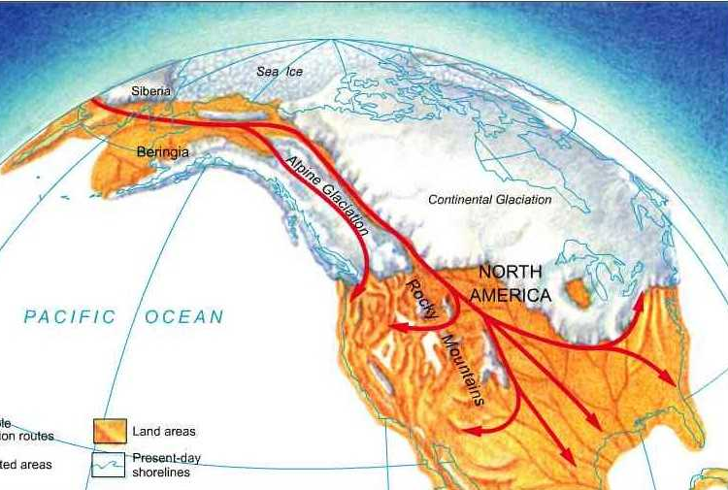
Manufacturing diversity
15000 years of diversity
Pr(A|A)≈ 1/3000
all Native Americans
Tribe: geographical subpopulation isolated from immigration
15,000 ybp
Y-
Hopi
600? years of diversity
1/10 < Pr(A|A) < ?
Notes:
Native Americans began to populate the Americas 15000 years ago. I assume that genetically and geographically separate subpopulations – tribes – formed from time to time.
Note – “population” here literally means Y-chromosomes, reasonably thought of like bacteria. Females participation is just incubation; they have no genetic or population-genetic role. There is no “HW equilibrium” concept. Even the males are essentially vessels.
The Y haplotypes of an insular community – Nat Am tribe for example – are not fairly represented by the pooled data from all the tribes. For the large population and 15K year age represented by pooled population data, the typical random match probability is 1/3000. For a much younger and smaller individual tribe it is much less; some data supports as little as 1/10.
The tribe will have much less diversity. Moreover its haplotypes may largely be tribe-specific types not existing elsewhere.

Slide 5
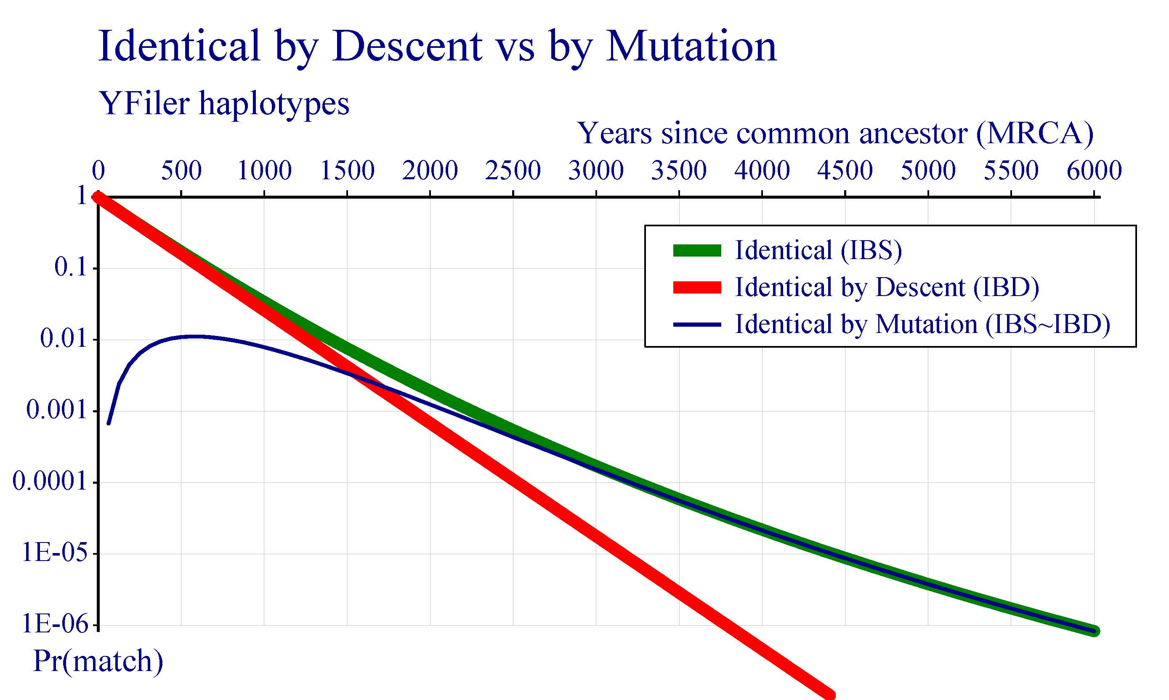
IBD dominates Yfiler matching

Slide 6
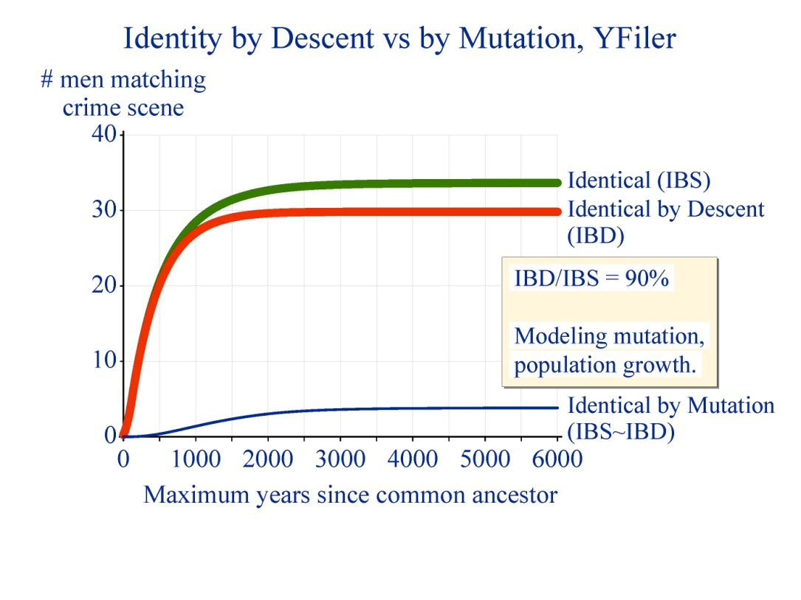
Notes:
Simpler than Andersen / Balding. Their simulation models variable numbers of sons. I did a simple calculation modeling all men as equally prolific.
Not 100% certain that I correctly implemented my model.

Slide 7
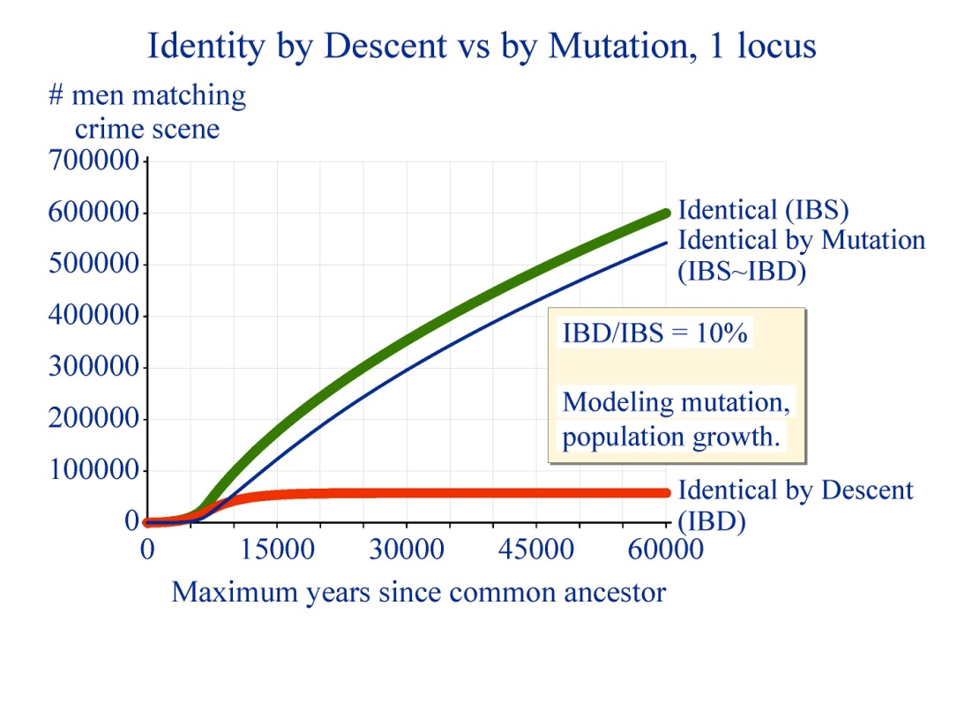
Haplotypes are NOT just super-polymorphic loci
Moral –
Y-haplotype modeling rule #1:
All men are related.
.
Haplotype
IBD – patrilineal link without intervening mutation.
STR locus
coincidence.
matching is dominated by

Slide 8
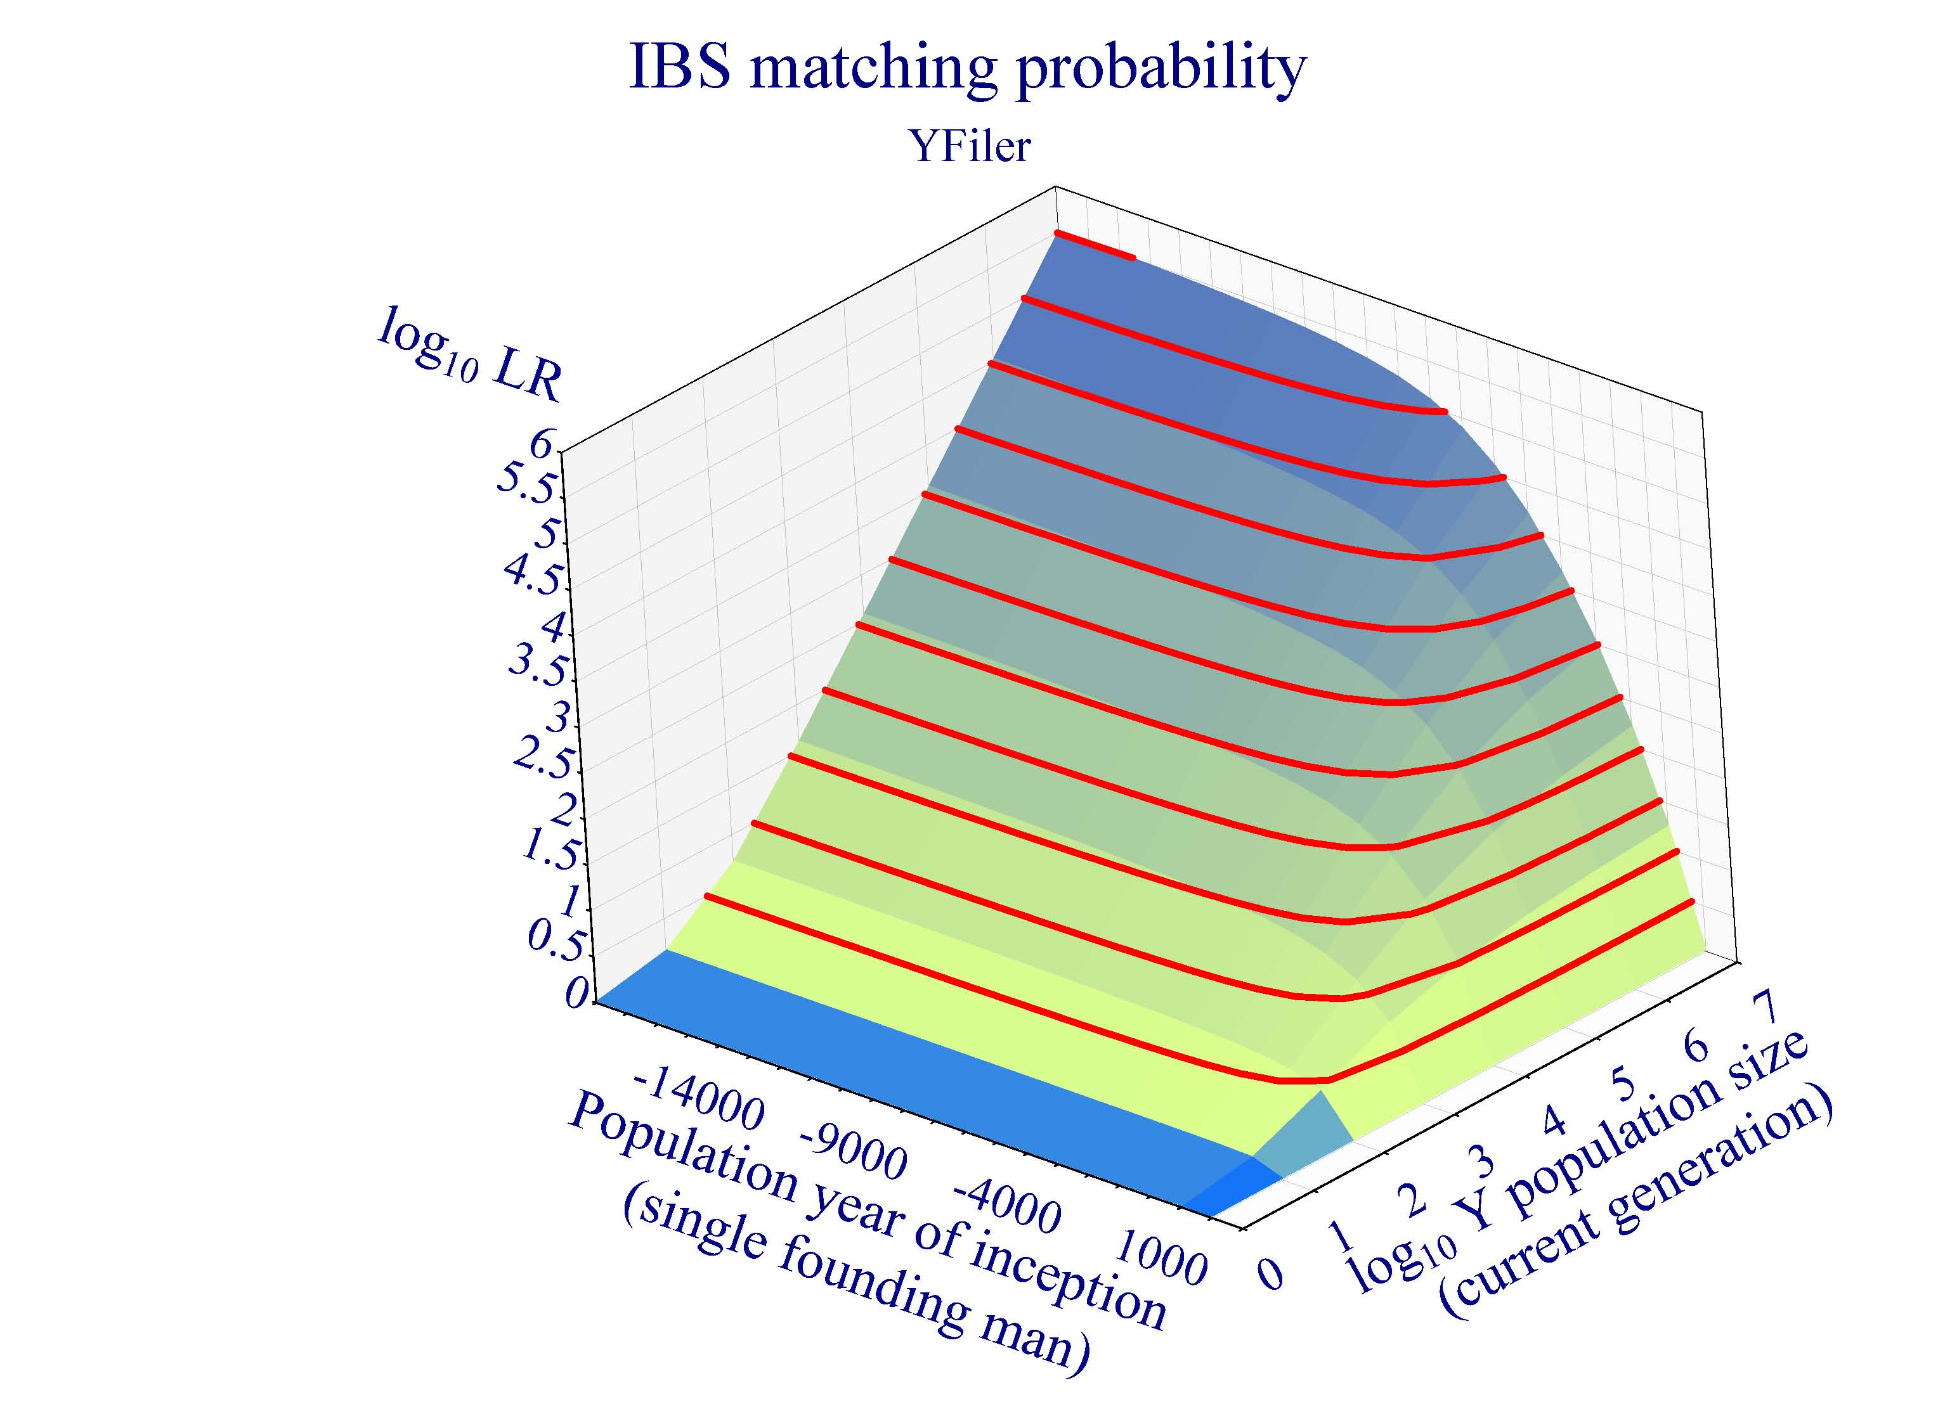
Evidential strength of Y haplotype match
Model: constant population growth rate
from 1 founding man to N men today..
Matching evidence
increases with population size.
Population age is unimportant.
L
BC
Y
AD
N

Slide 9
Haplotype cohort size vs populations size
Straight? Yes
& 45°? Close
  Andersen/Balding: cohort size independent of population size
Close
  10-30% cohort increase per
  10x population increase
L
Straight & horizontal? Close
  Implies cohort size nearly independent of population growth rate
Y
N

Slide 10
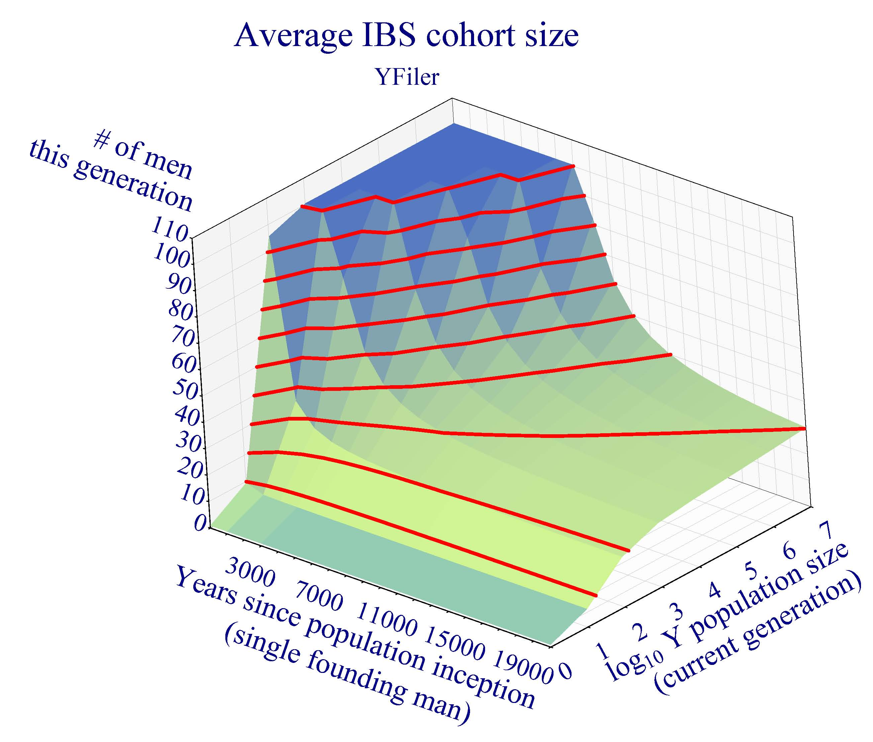
Number of men* with same haplotype
Assume constant population growth
over Y years
from 1 founding man to N men today.
Then typical Yfiler haplotype is shared by H<100 men in the present generation.
H
Y
N
* Nod to Andersen & Balding

Slide 11

Summary
  Number of men per cohort is mostly independent of (unknowable, undefinable) population size.
    For isolated population – useful forensic number.
Extend results of Andersen/Balding (2018) & Brenner (2014)
  Detailed population history not needed
Exact calculations from model (not simulation)
  Better focused results
  Quick: 5 minutes to model back to Y-haplotype Adam
I’ve (deliberately) chosen simplest model.
  More work is possible.

Slide 12

charles@dna-view.com
http://dna-view.com
☎+1 510 798 7139
The end
This work received no support from the NIJ, IMF, World Bank, Bill and Melinda Gates, or the Ford Foundation. Even Queen Isabella of Spain (usually a soft touch) wouldn’t pitch in.

Slide 13
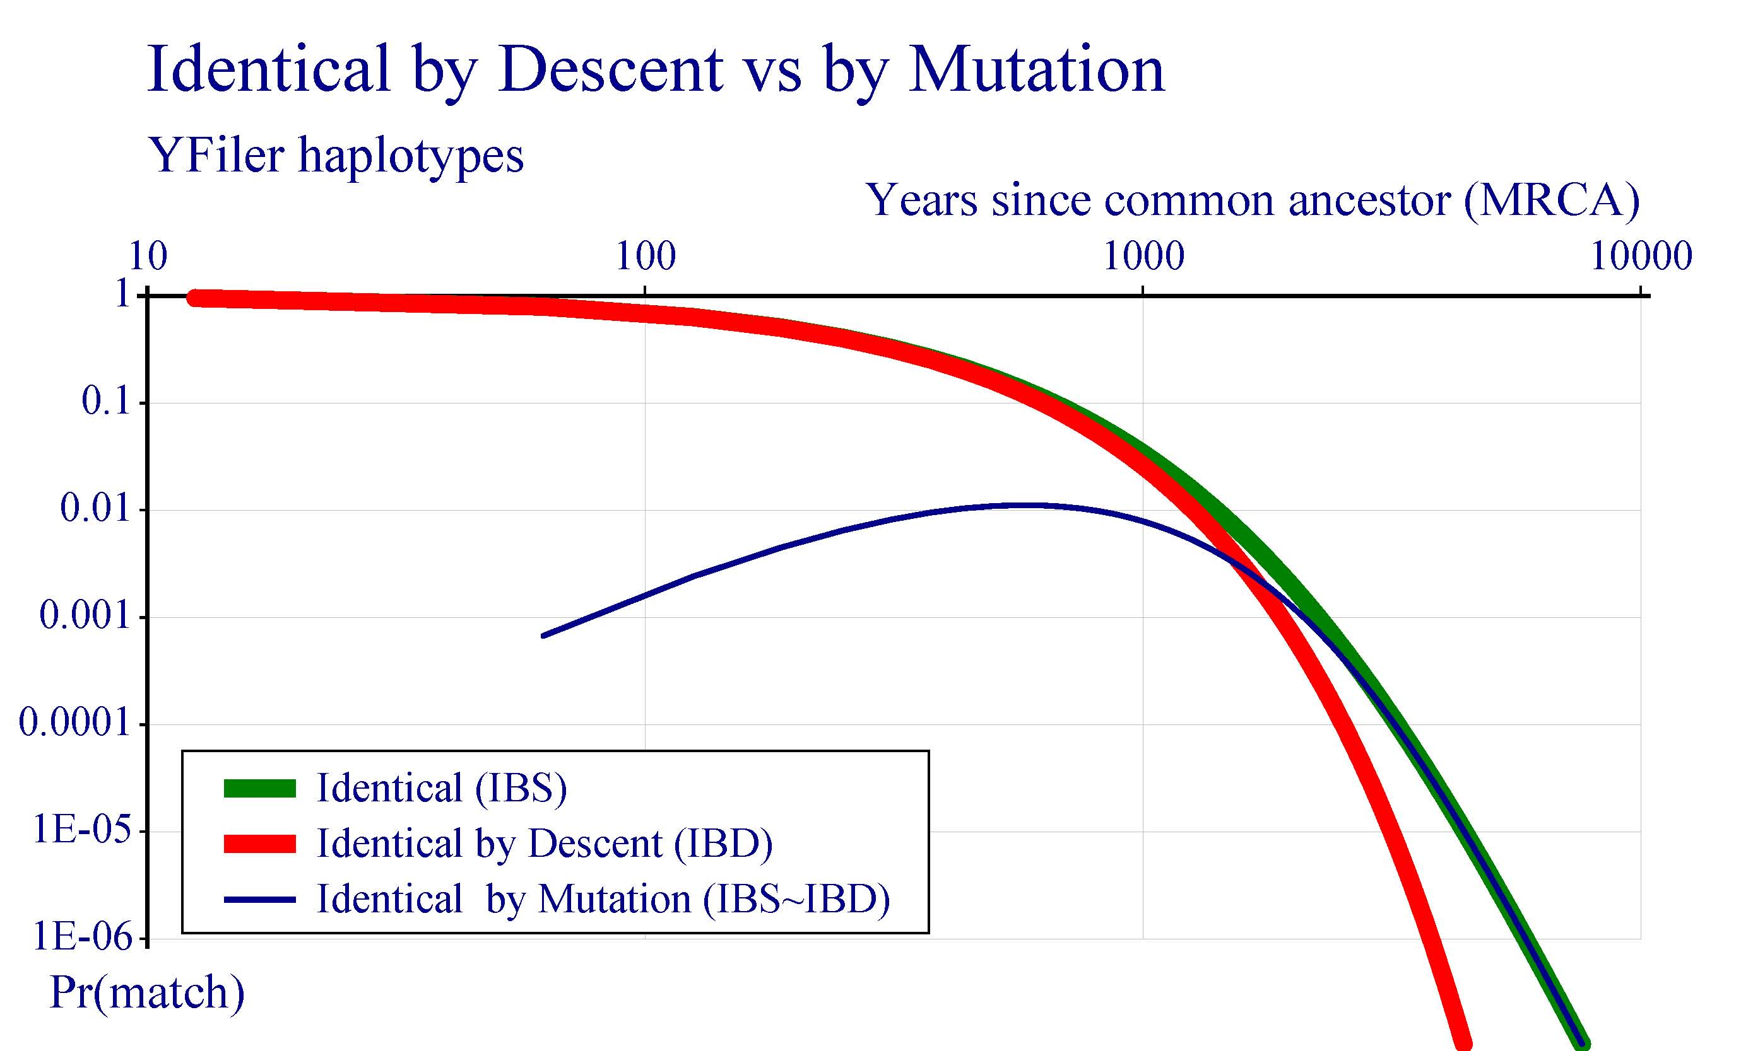
Notes:
Same as previous but log scale like my 2014 “Understand Y” paper.

Slide 14
Ancestry dominates Y matching
Autosomal STR allele A
Y haplotype T
Many A families
5% of matching is family
Convergent mutation common
One dominant T family
90% of matching is family
Convergent mutation insignificant
10000 years
500 years
Notes:
Old slide – 97% should be only 90% (for Yfiler)

